Slide 1

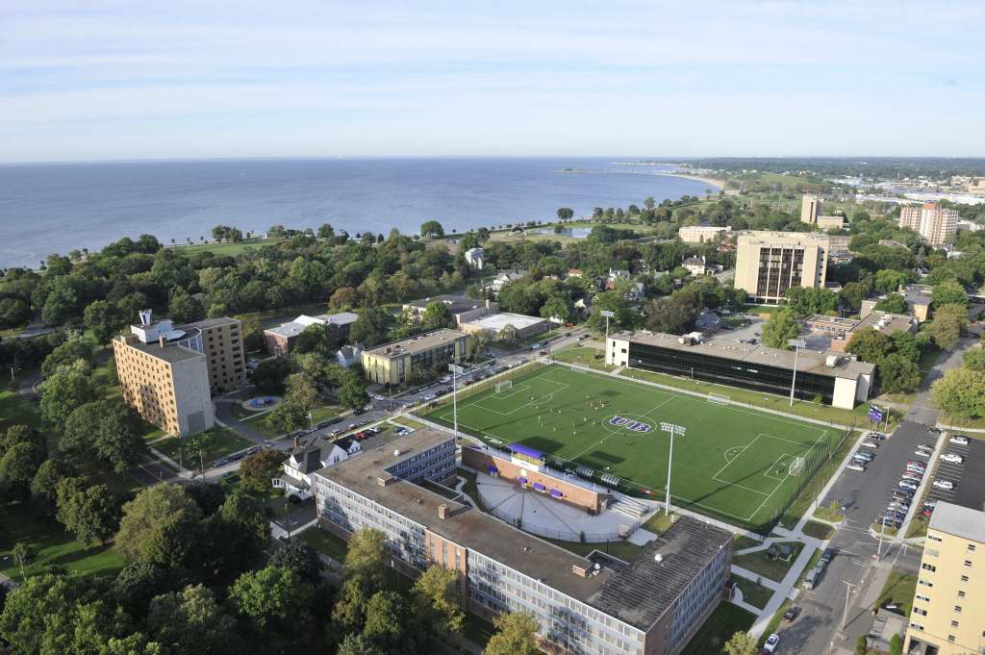
University of Bridgeport
“Opening Doors, Building Futures”
Overview
Graduate Schools of Business and Engineering Degree Programs
Dr. Tarek Sobh
Vice President Graduate Studies and Research Division &
Dean, School of Engineering
Distinguished Professor of Engineering & Computer Science
University of Bridgeport
E-Mail: sobh@bridgeport.edu
Why UB is GREAT
For You ?
September, 2010
Notes:
UB-MKT-10/08/07
1
Review Packet of Material
PowerPoint Printout for Notes
CBIT Brochure
Financial Aid Information
Application
Summer Schedule
Summer Discount Program
Open House Information Sheet
Additional Materials for Distribution
Course Catalogs
Exam Info: Mcse, Mcsa, Mcad

Slide 2
Outline
Overview – University of Bridgeport
Focus on Inter-Disciplinary Competencies and Skills for the 21st Century
Graduate Degree Programs – Schools of Business and Engineering
Dual Master’s Degree Programs and Concentrations
Student/Graduate Employment
Financial Scholarships and Stipends
CTech IncUBator @ University of Bridgeport
Questions
Appendix – Research Areas

Slide 3

University of Bridgeport
Founded in 1927
Accredited, private, doctoral level institution
Located in the state of Connecticut, city of Bridgeport
Student body representing over 80 countries
5,000 + Students

Slide 4
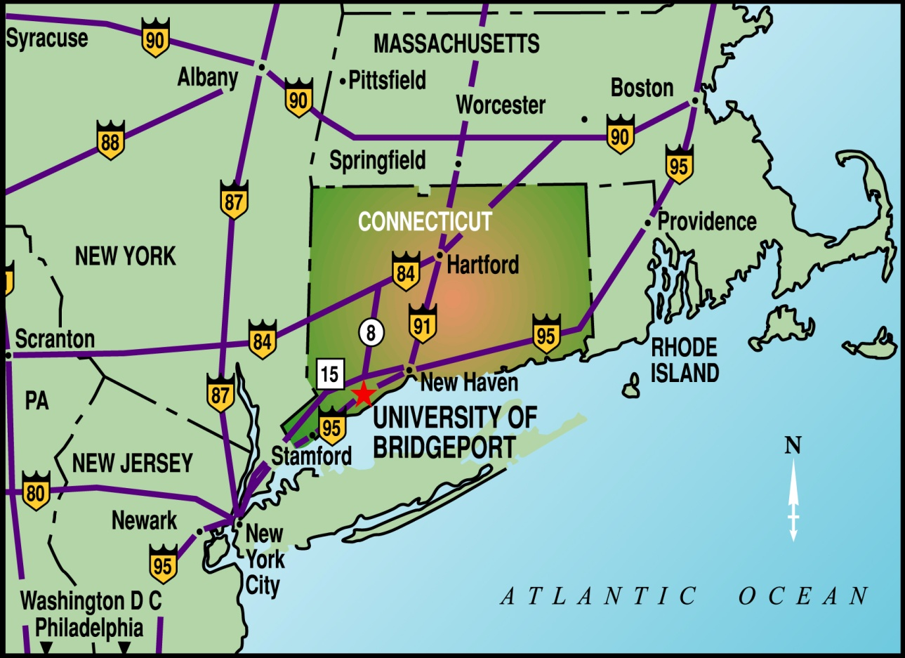
Ideal Location!!!
Fairfield County is known as the ‘Corporate Gold Coast’ - 3rd highest concentration of Fortune 500 companies in USA
Located in the State of Connecticut, Fairfield County, City of Bridgeport
New York City - 1 Hour
Boston, MA - 2 Hours
Washington, D.C. - 5 Hours

Slide 5
UB Schools
School of Business | School of Engineering | School of Design | School of Arts & Sciences
College of Naturopathic Medicine | Nutrition & Acupuncture Institutes | College of Chiropractic | Fones School of Dental Hygiene
International College | School of Continuing & Professional Studies | School of Education & Human Resources | ELI – English Language Institute
* In Process – Physicians Assistant Program with St. Vincent’s Medical Center & Pre-Pharma with University of Connecticut.

Slide 6




Accreditations
The University of Bridgeport is fully accredited by the New England Association of Schools and Colleges
The University is also accredited by the Board of Governors of the Connecticut Department of Higher Education
The School of Business is accredited by the Association of Collegiate Business Schools and Programs (ACBSP)
The School of Engineering is accredited by the Accreditation Board for Engineering and Technology (ABET)

Slide 7
UB Enrollment
7,000
6,500
6,000
5,000
5,323
5,150
4,000
3,000
3,274
2004
2005
2006
2007
2008
2009
2010
2011
2012
2013
Fall 2010: Total No. of Graduate Students - 51.00 % (2627 Students)
No. of SOE Graduate Students - 34.00 % ( 900 Students)
No. of Business Graduate Students -15.00 % ( 400 Students)
MKT-SOB-SOE & IncUBator-Sobh-9.14.2010

Slide 8
Inter-Disciplinary Management, Engineering, Technology & Leadership Competencies
Business/
Industry Knowledge
& Process Skills
Leadership, People & Team Building Skills
Technical/
Engineering
Skills

Slide 9
Current Graduate Degree Programs – Business & Engineering
M.S. in B.E. (Biomedical Engineering)
M.S. in C.S. (Computer Science)
M.S. in CpE (Computer Engineering)
M.S. in E.E. (Electrical Engineering)
M.S. in M.E. (Mechanical Engineering)
M.S. in T.M. (Technology Management)
M.B.A./E.M.B.A. (Business Administration)
M.S. in MSIT (Instructional Technology)
M.S. in Counseling/HR (Counseling & Human Resources)
PhD. in C.S. & CpE (Computer Science & Engineering)
PhD in T.M. (Technology Management - Proposal
Completed and Under Review)

Slide 10
Concentrations
Accounting
Automation & Robotics
Bio-Tech/Bio-Medical Management & Technology
CAD/CAM
Computer Communications/Networking
Corporate, Government and Information Security & Continuity Management
E-Commerce
Entrepreneurship/New Venture Creation
Environmental and Energy Management
Global Business
Global Marketing
Global Management
Finance
Global Program and Project Management
Health Care Management and Administration
Human Resource Management
Information Technology
Intellectual Property Management
Management and Operations
Manufacturing Management
Modern Data Base Systems
New Product Development & Commercialization
Service Management and Engineering
Software Engineering
Strategic Sourcing and Vendor Management
Supply Chain Management
Wireless and Mobile Communications
Very Large Scale Integration (VLSI)

Slide 11
Enrollment Growth for TM, MBA and Graduate Engineering Students - Spring, 2005 – Spring 2009

Slide 12
Total Graduate School of Engineering Enrollment Fall, 2005 – Spring 2009
Total Engineering | 360 | 411 | 591 | 915 | 1189 | 1254 | 1477 1045

Slide 13
MS – Technology Management Curriculum & Choices*
TM Core Courses *
Choice of Concentrations
& Electives (27 Choices)**
Marketing, Entrepreneurship & Innovation
Total Quality Management & Continuous
Process Improvement
Finance & Accounting for Managers
Leadership, Teams and Managing Change
Global Program and Project Management
Business Policy and Strategy – Capstone / Project
Contemporary Issues in Communications and
Quantitative Techniques
Engineering Colloquium (1 credit)
Bio-Technology and/or Bio-Medical Management
and Technology
Computer, Networking Software and DBMS
Intellectual Property Law
Information Technology
Entrepreneurship
Environmental & Energy Management (Sustainability)
Strategic Marketing
New Venture Creation/Entrepreneurship/Intrapreneurship
Manufacturing and Operations Management
New Product Development & Commercialization
Program & Project Management
Service Management & Engineering
Strategic Sourcing & Outsourcing
Supply Chain & Logistics Management
Engineering and Management Finance
Leadership and Management
+++++
Required Courses: 8 Courses for Degree
4 Electives – Can be chosen
*Minimum Total Credits Required = 34 Credits for Graduation
Notes:
13

Slide 14
MS – Computer Science Curriculum *
CS Core Courses
Choice of Electives
Advanced Object Oriented Programming Using
C++
Algorithm Design
Operating Systems
Data Base Design
Data and Computer Communication
Graduate Project
Engineering Colloquium (1 credit)
Computer Networks
Local Area Networks
Network Administration
Advanced Data Base Design
Multimedia Data Base Design
Windows Programming
Unix System Programming
Services Oriented Architecture
Java Programming
Advanced java Programming
Computer Architecture
Robotics
Advanced Robotics
Mobile Communication
Wireless Communication
Required Courses: 7 Courses for Degree
5 Electives Must Be Chosen
*Minimum Total Credits Required = 34 for Graduation
Notes:
14

Slide 15
MS – Computer Engineering Curriculum *
CS Core Courses
Choice of Electives
Advanced Object Oriented Programming Using
C++
Digital Signal Processing
Computer Architecture
Logic Synthesis Using FPGAs or VLSI Design
Data and Computer Communication
Graduate Project
Engineering Colloquium (1 credit)
Computer Networks
Local Area Networks
Network Administration
Analog VLSI Design
VLSI (Very Large Scale Inegration)
Windows Programming
Unix System Programming
Image Processing
Software Engineering
Java Programming
Network Security
Robotics
Advanced Robotics
Mobile Communication
Wireless Communication
Required Courses: 7 Courses for Degree
5 Electives Must Be Chosen
*Minimum Total Credits Required = 34 for Graduation
Notes:
15

Slide 16
MS – Electrical Engineering Curriculum & Choices*
Core courses are decided by the student pursuing a particular concentration; courses come from a list of almost 100 different courses; student should be guided by the department's research areas.
All courses are at the 400 or 500 level.
All courses in EE and Computer Science and Computer Engineering are accepted toward the MSEE.
A minimum of 30 credits is required for the MSEE
Master's Project or Thesis is required
One course in either Technology Management or Mechanical Engineering may be taken, but this is not necessary.
Concentrations available in Electrical Engineering are:
VLSI, Signal Processing, Energy and Power, Medical Electronics, Solar Cells, Electrical Accident Reconstruction, MEMs, Electrical materials/Composites, PLC (Programmable Logic Control)

Slide 17
MS – Mechanical Engineering Curriculum & Choices*
ME Core Courses
Choice of Concentrations
Traditional Concentration Area
MEEG 410 Advanced Fluid Dynamics
MEEG 452 Advanced Vibration
MEEG 453 Finite Element Methods
MEEG 454 Advanced Dynamics
MEEG 463 Advanced Heat Transfer
Math 401 Advanced Analysis
Master’s Project
Engineering Colloquium (1 credit)
Design Management Concentration Area
(Take 3 credits from Traditional Core Courses)
Computer Aided Engineering/Design
Advanced CAE/CAD Projects
CAM & NC Machining
Design & Innovation
Ergonomics
Intellectual Property & Technology
Manufacturing Management Concentration
Area
(Take 3 credits from Traditional Core Courses)
Materials & Methods in Manufacturing
Advanced CAE/CAD Projects
Innovations & Product Development
Production Technology & Techniques
Supply Chain Management
Principles of Logistics and Materials
Manufacturing Management
Robotics and Automation
Materials
*Minimum Total Credits Required = 30 for Graduation
Notes:
17

Slide 18
MS – Biomedical Engineering Curriculum & Choices*
Core courses are decided by the student pursuing a particular concentration; courses come from a list of several interdisciplinary biomedical engineering courses student should be guided by the BME program research areas.
All courses are at the 400 or 500 level and research project is 600 level.
Many courses in EE, Computer Science and Computer Engineering, TM and ME are accepted in MS BME program.
A minimum of 33 credits is required for the MSBME
Team based research project of 6 credit is compulsory
Concentrations available in Biomedical Engineering are:
Biomaterials, Tissue Engineering, Bioelectronics and Biomedical Electronics, Biobased Energy and Power, Bio-MEMs, Biosensing, Bioimaging, Biomechanics, Bio-instrumentation, Biorobotics, Electrochemistry in biosystems, Bio-signaling, Communication in biological systems

Slide 19
MBA with a Difference
Most internationally diverse student body in America
Students build the program they want. Not a cohort-based program
Doctorally qualified faculty augmented by industry-expert instructors
Degree may be earned in as few as 30 credits and up to 54 credits, depending on undergraduate degree and prerequisite requirements
Flexible classes offered seven days a week with an accelerated weekend format
Classes offered year round
MKT-SOB-SOE- 9-10-09
19

Slide 20
MBA Concentrations
Accounting
Entrepreneurship
Finance
Global Business
Global Marketing
Global Management
Information Systems (MIS)
Fashion Merchandising
Healthcare Management and Administration

Slide 21
MBA Curriculum
*Core Courses – May Be Waived
Majors and Required Courses
Financial Accounting
Economics
Financial Management
Introduction to information Systems and
Technology
Leadership and Management
Legal Environment of Business and Ethics
Marketing
Statistics and Quantitative Analysis
Major Areas of Study | Capstone & Required Courses
Accounting Finance Financial Services Global Financial Services General Business Human Resources Management Information Systems and Knowledge Management International Business Management Operations Marketing Small Business and Entrepreneurship Specialized Business | Business Research Integration and Application: Strategy Integration and Application: Business Simulation and Planning Integration and Application: Internship or Integration and Application: Thesis
Courses: 8 Courses (24 Credits)
A Minimum of One Major Must Be Taken
*Core Courses May Be Waived (if Student is Qualified in the Subject Area)
Notes:
21

Slide 22
Inter-Disciplinary (Dual) Graduate M.S. &/or M.S./MBA Degree & Certificate Programs – Business, Engineering & Education
BME/C.S. or CpE | C.S./CpE | C.S./MSIT | CpE/MSIT | M.E./MBA
BME/E.E. | C.S./E.E. | CpE/E.E. | E.E./M.E. | M.E./T.M.
BME/M.E. | C.S./MBA | CpE/M.E. | E.E./MBA | T.M./MBA
BME/T.M. | C.S./M.E. | CpE/MBA | E.E./MSIT | T.M./MSIT
BME/MBA | C.S./T.M. | CpE/T.M. | E.E./T.M. | Couns. & HR/MBA

Slide 23

Committed and Caring Faculty
500+ full-time professors and adjuncts
Highly credentialed, i.e. New York University, Fordham University, MIT, Pennsylvania State University, Columbia University, etc.
18:1 student-faculty ratio
Fulbright Scholars, National Science Foundation Fellows, Ford Fellows
Actively involved in research, publishing, conferences

Slide 24

Understanding The Needs of International Students
Dedicated Office of International student services
F1 student legal advice
24/7 Travel Signatures
OPT & CPT
Driver’s License and Social Security
International Festival

Slide 25
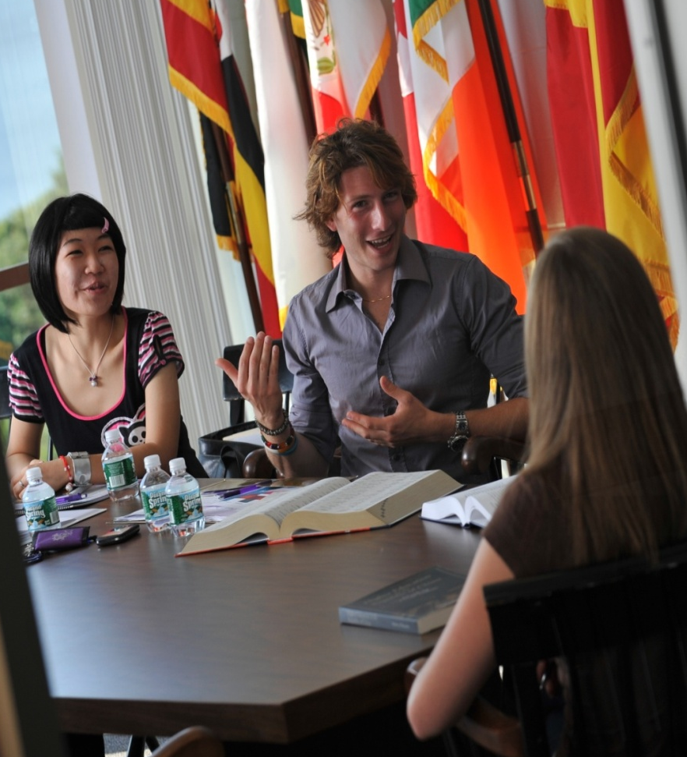
Student Life
More than 45 registered clubs and organizations:
Club India, East Meets West Club,
Student Government, Multicultural Club, “The Scribe” (student-run newspaper), etc.
Community Service and Volunteer Projects:
Tutoring and mentoring local children, Habitat for Humanity, Alternative Spring Break
“Twisted Café” student-run coffee shop
UB Shuttle Service provides free transportation 7 days a week
Close proximity to New York City, and Port Jefferson, Long Island

Slide 26

International Festival
Talent Competitions, Flags Parade
International Cuisine
Ethnic Artifacts Expo

Slide 27
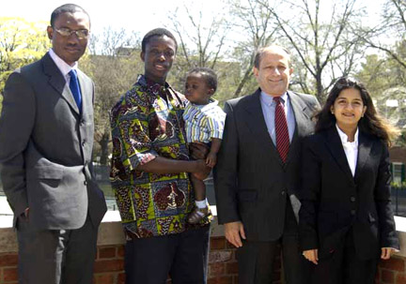
Graduate Student Opportunities –
UB Team Winners
State of Connecticut Collegiate Business Plan Competition Winners
University of Bridgeport Schools of
Business and Engineering student
teams won first and second place
awards in the graduate personal
business category UB
School of Engineering team won first
place award in the graduate venture category in the Connecticut Business Plan Competition.
The semi-annual event, sponsored by the Connecticut Venture Group and the
State Department of Economic Development, drew more than 50 entries from student teams in the state’s colleges and universities. Only 15 of those made the finals.
University of Bridgeport Business School Professor Gad Selig, second from right, with first prize winners in the graduate division for their business plan on a date rape drug detector, from left: Udeme Idiong, Sana Sarr and his son, Sana Prince, and Gauri Jayawant.

Slide 28
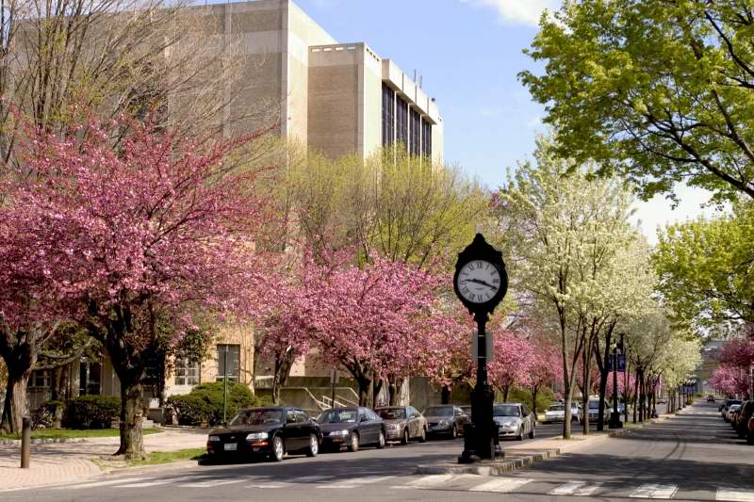

Safety

Slide 29

Student Employment
Career Center
On-Campus Employment using the QuesTRAK System
Job Search Skill Development
Career Fairs and Campus Recruiting
Job and Internship Listings
Career resource library
CPT (Curricular Practical Training)
OPT (Optional Practical Training)

Slide 30
Financial Stipends and Scholarships
165 Engineering and Business programs assistantships based on academic merit: 4 credits tuition waiver for two consecutive semesters
Dean’s Assistantships: 9 credits tuition waiver and $10,000 living costs waiver for two consecutive academic semesters for Engineering
Graduate Assistantships, Research Assistantships and Student Workers employment available
Payment plans option available after your 1st semester

Slide 31
Financial Stipends and Scholarships – Graduate Students
New Scholarship Program available for incoming domestic and international graduate students with award amounts of $3,000, $4,000 and $5,000 per academic year for the first year graduate students in select Schools of Business, Engineering, Education and Human Resources and International College programs. Eligibility for the award is based on the student’s record of academic achievement & test scores.

Slide 32


A Partnership of:
Connecticut Innovations Inc. (CI)
&
University of Bridgeport (UB)

Slide 33
Value Proposition/Objectives
Nurture and facilitate growth of new businesses and jobs in high technology and technology ventures
Foster and stimulate economic development and job creation in Greater Bridgeport, Fairfield County and the State of Connecticut
Support and enable the growth and commercialization of UB’s applied research & Intellectual Property initiatives (e.g. U.S. Army Hybrid Projectile Design initiative – part of $2.4 million grant; NSF Smart Browsing Systems for Endoscope videos – $147,655 pending grant)
Build synergy and collaboration among industry, education and government sectors
Become self-sustaining: generate revenues through rent income, IP royalties, license fees, sponsor contributions, grants, donations, etc.
Leverage educational, faculty, student interns and facility resources for career and economic development

Slide 34
Target Market – CTech IncUBator @ University of Bridgeport
Greater Bridgeport / Fairfield County / Connecticut:
New start-ups
Early stage companies
Connecticut Innovations Portfolio Companies
UB Students / Faculty:
School of Engineering
School of Business
Schools of Health Sciences
Shintaro Akatsu School of Design

Slide 35
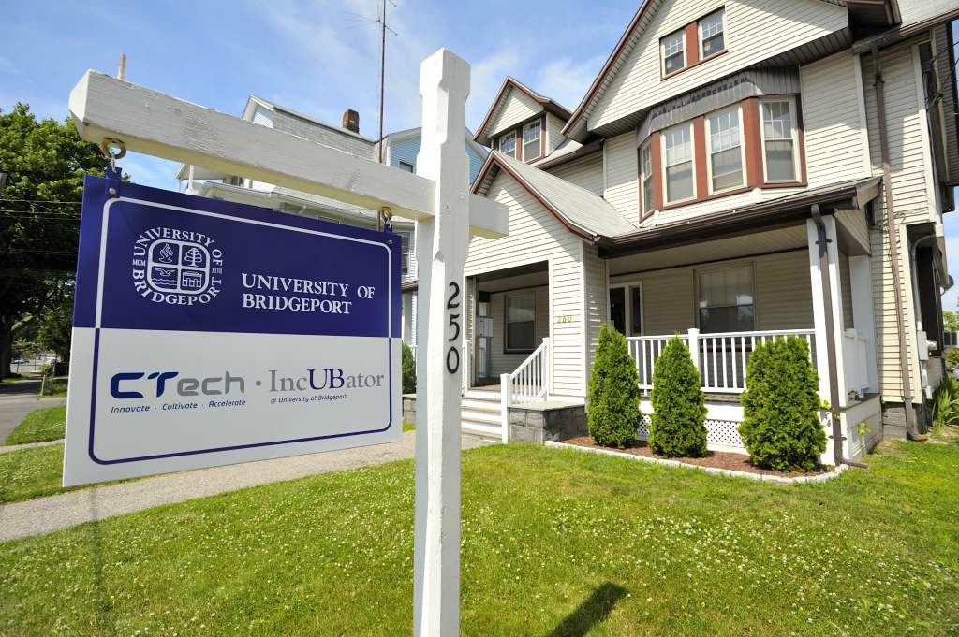
CTech IncUBator
250 Myrtle Avenue, Bridgeport, CT 06604
250 Myrtle Avenue, Bridgeport, CT 06604
Six offices ranging from 130 to 240 sq. ft.
Shared conference room with Monitor
Shared Kitchen
Internet Access and Utilities included in rent
Security camera linked to UB security
Shared Copy/Fax/Printer

Slide 36
CTech IncUBator Tenant Services & Resources
Favorable market rents in a high-energy, entrepreneurial environment. Rent includes utilities
Shared support services (e.g. conference room, high speed internet connectivity, printer/copier/fax/scanner and a kitchen)
Pro-bono and discounted professional services assistance (e.g. legal, accounting, intellectual property, technology, product commercialization and SCORE advisors)
An entrepreneurial environment conducive to exchanging information, ideas and solutions
Access to facilities and resources like the library, gym, pool, café, coffee bar, world class laboratories and many more located on campus
Introductions to potential investors and pre-seed and seed funding programs
Access to public and private grant and joint research opportunities
Access to world class faculty members and exceptional student interns
Monthly “Entrepreneurial Brown Bag Lunch” free seminars and events

Slide 37
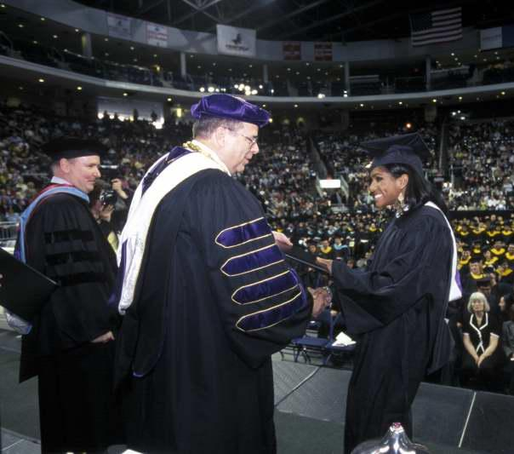
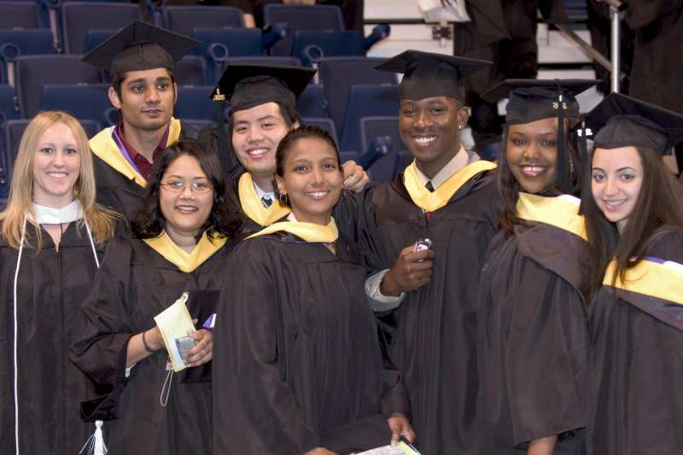
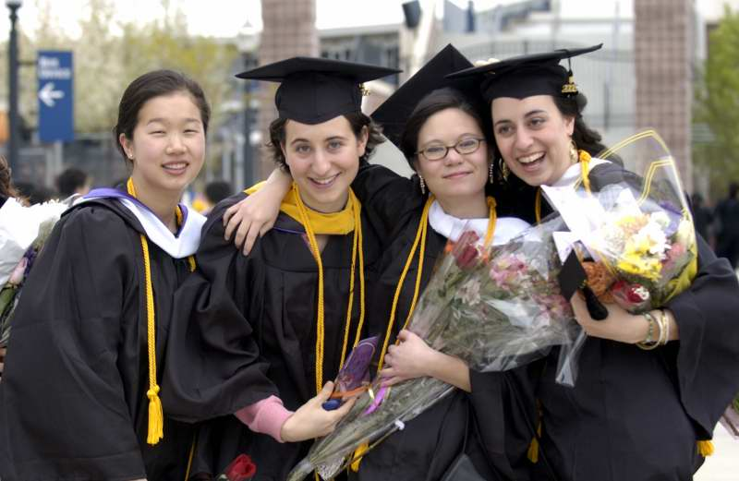
Opening Doors, Building Futures
University of Bridgeport - strongly committed to academic development and professional accomplishments!!!

Slide 38
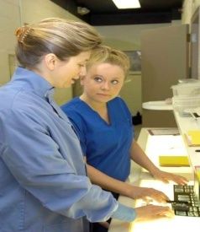
Why Study at UB ?
UNIVERSITY of Bridgeport
FACULTY
FACILTIES
INTERNSHIPS
LOCATION
AFFORDABLE

Slide 39














Representative Companies Who Have Hired UB Interns and/or Graduates
Aetna
ATMI
ATW Bodine
Avon
Bendix
CitiCorp (Bank)
GE
IBM
Intel
IPC
Purdue Pharma
Peoples United Bank
Pitney Bowes
TNT Expense Management
UBS (Bank)
United Technologies

Slide 40
Opening Doors, Building Futures
Questions?
Believe in Yourself!
Dr. Tarek Sobh
Vice President Graduate Studies and Research Division &
Dean, School of Engineering
Distinguished Professor of Engineering & Computer Science
University of Bridgeport
E-Mail: sobh@bridgeport.edu

Slide 41
Appendix
Research Areas
UB Graduate students in the School of Engineering and the School of Business consistently win national and international research and education competitions and routinely publish in prestigious journals and conferences.

Slide 42
Research Areas – Technology Management
Bio-Medical/Bio-Technology and Management
Business and Information Technology Continuity and Security
Environment and Energy Management and Technology (including Green and Sustainability)
Entrepreneurship, Intrapreneurship & New Venture Creation
Creating & Sustaining High Performance Global Leaders and Teams
New Product/Service Development and Commercialization
Strategic Marketing, Demand Creation, Growth and Innovation
Information Technology
Outsourcing and Strategic Sourcing
Quality Management and Lean Process Management
Global Program and Project Management
Supply Chain Management & Logistics
Corporate and Information Technology Strategy, Execution & Governance
Manufacturing and Operations Management
Service Management
Sports Technology and Management (Future)
Engineering and Science Management
++++

Slide 43
Research Areas - Computer Science & Engineering
Automation and Manufacturing
Biomedical Engineering
Computer Architecture
Computer Arithmetic
Computer Networks
Control Systems
Digital Signal Processing & Image Processing
Multimedia Data Base Application
Formal Approaches for Design, Synthesis and Verification
Parallel and Distributed Architectures and Algorithms
Robotics
Scalable Web Architectures, SOA, GPS Applications.
Microelectronic Design
Wireless Communication

Slide 44
Research Areas - Electrical Engineering
Distributed control and optimization
Electrical Properties of Plastic/Metal Composites
Electrical Safety and Electric Accident reconstruction
Electromagnetic Fields Applied To Lightning
Electronic Biological Sensors
Electronic Materials and Devices
Information processing and control of large-scale distributed systems
Medical Electronics & Bio-Medical
Micro-electromechanical Systems (MEMS)
Micro-sensors and Micro-actuators
Superconductors
Thin-film Solar Cells
VLSI design and testing
PLC (Programmable Logic Control)

Slide 45
Research Areas – Mechanical Engineering
Automation control
Biomechanics of manipulation
Biomedical equipment design
Design/Shape optimization
Computational fluid dynamics
Finite element analysis
HVAC
Heat Transfer
Human performance effects of manipulation of the extremities
Laser material processing
Manufacturing
Nanomaterials
Biomaterials and bioinspired materials
Prototyping
Robotics
Thermal management of electronic devices and systems
Welding
BIM – Building Information Modeling

Slide 46
Research Areas – Bio-Medical Engineering
Biomedical materials
Biomimicking and bioinspired materials
Bioelectronics
BioMEMS
Biosignal processing
Biorobotics
Bioimage processing
Ergonomy
Bioinformatics
Gene sequencing
Communication in man-machine interface
Biosensing
Tissue Engineering
Cellular and molecular biology
Biometrics
Biomechanics
Biotechnology

Slide 47
Thank You
Questions?
Contact:
Dr. Gad J. Selig, PMP. COP
Associate Dean, Business Development and Outreach,
Graduate Studies and Research Division
E-mail: gadselig@bridgeport.edu
Telephone: 203-576-4870

